Slide 1
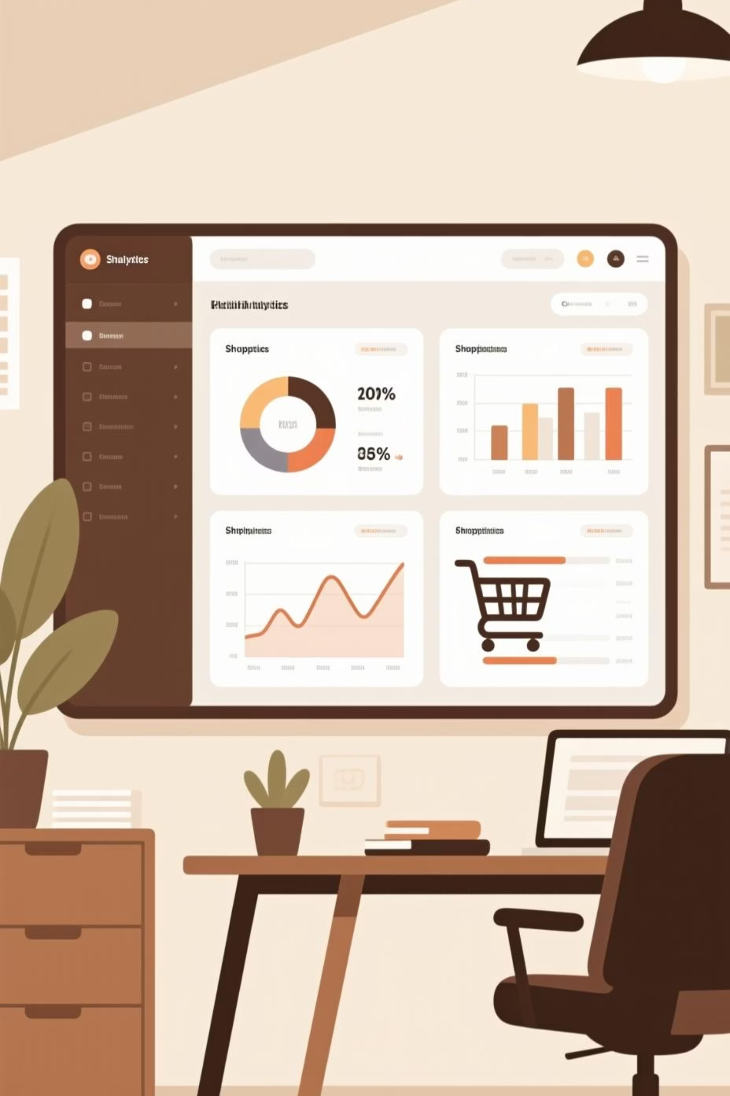
Customer Shopping Behavior Analysis
Analyzing 3,900 purchases to uncover insights into spending patterns, customer segments, and product preferences that drive strategic business decisions.

Slide 2
Dataset Overview
3,900
18
50
25
Total Purchases
Data Features
Locations
Product Types
Transactions analyzed across all categories
Comprehensive customer and purchase attributes
Geographic diversity in customer base
Diverse inventory across categories
Customer Demographics
Shopping Behavior
Age, Gender, Location
Discount & Promo Usage
Subscription Status
Review Ratings
Purchase History
Shipping Preferences

Slide 3

Data Preparation & Cleaning
01
Data Loading & Exploration
Imported dataset using pandas, examined structure with df.info() and summary statistics
02
Missing Data Handling
Imputed 37 missing Review Rating values using median rating per product category
03
Feature Engineering
Created age_group bins and purchase_frequency_days columns for deeper analysis
04
Database Integration
Connected to PostgreSQL and loaded cleaned data for SQL analysis

Slide 4
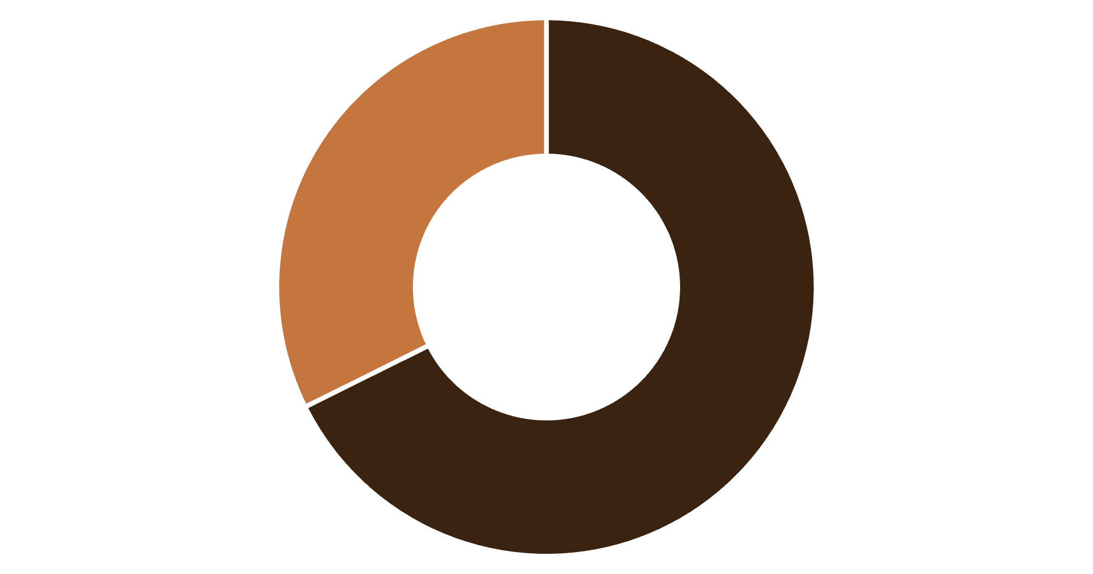
Revenue Insights by Gender
Male Customers Drive Revenue
Male customers generated $157,890 in total revenue, more than double the $75,191 from female customers.
This significant gap suggests opportunities for targeted marketing to female segments.
Male
Female

Slide 5


Smart Discount Users
839
21.5%
High-Value Discount Shoppers
Percentage of Total
Customers who used discounts but still spent above average purchase amount
Represents strategic discount users who maintain high spending
These customers demonstrate that discounts can drive volume without sacrificing revenue quality. They represent a valuable segment for targeted promotions.

Slide 6

Top-Rated Products
Gloves
Sandals
Boots
3.86 average rating
3.84 average rating
3.82 average rating
Hat
Skirt
3.80 average rating
3.78 average rating
These top-rated products should be prominently featured in marketing campaigns and inventory planning to capitalize on customer satisfaction.

Slide 7
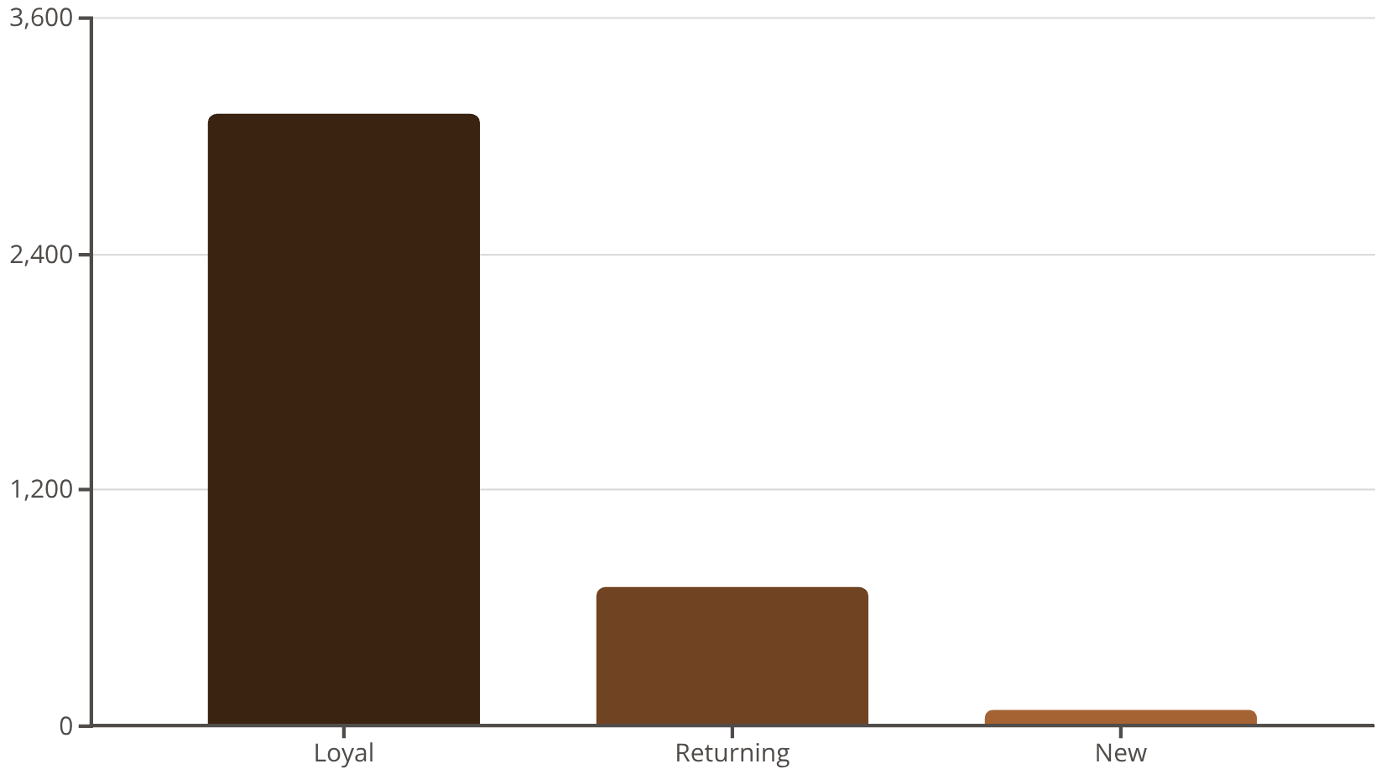
Customer Segmentation Analysis
Loyalty Dominates
80% of customers are classified as Loyal, demonstrating strong retention.
Focus on converting the 701 Returning customers into Loyal status through targeted loyalty programs and personalized experiences.

Slide 8

Subscription vs. Non-Subscription Performance
Subscribers
Non-Subscribers
1,053 customers
2,847 customers
Average spend: $59.49
Average spend: $59.87
Total revenue: $62,645
Total revenue: $170,436
Key Insight: While average spend is similar, the larger non-subscriber base represents a significant opportunity. Converting even 10% to subscribers could substantially boost predictable revenue.

Slide 9
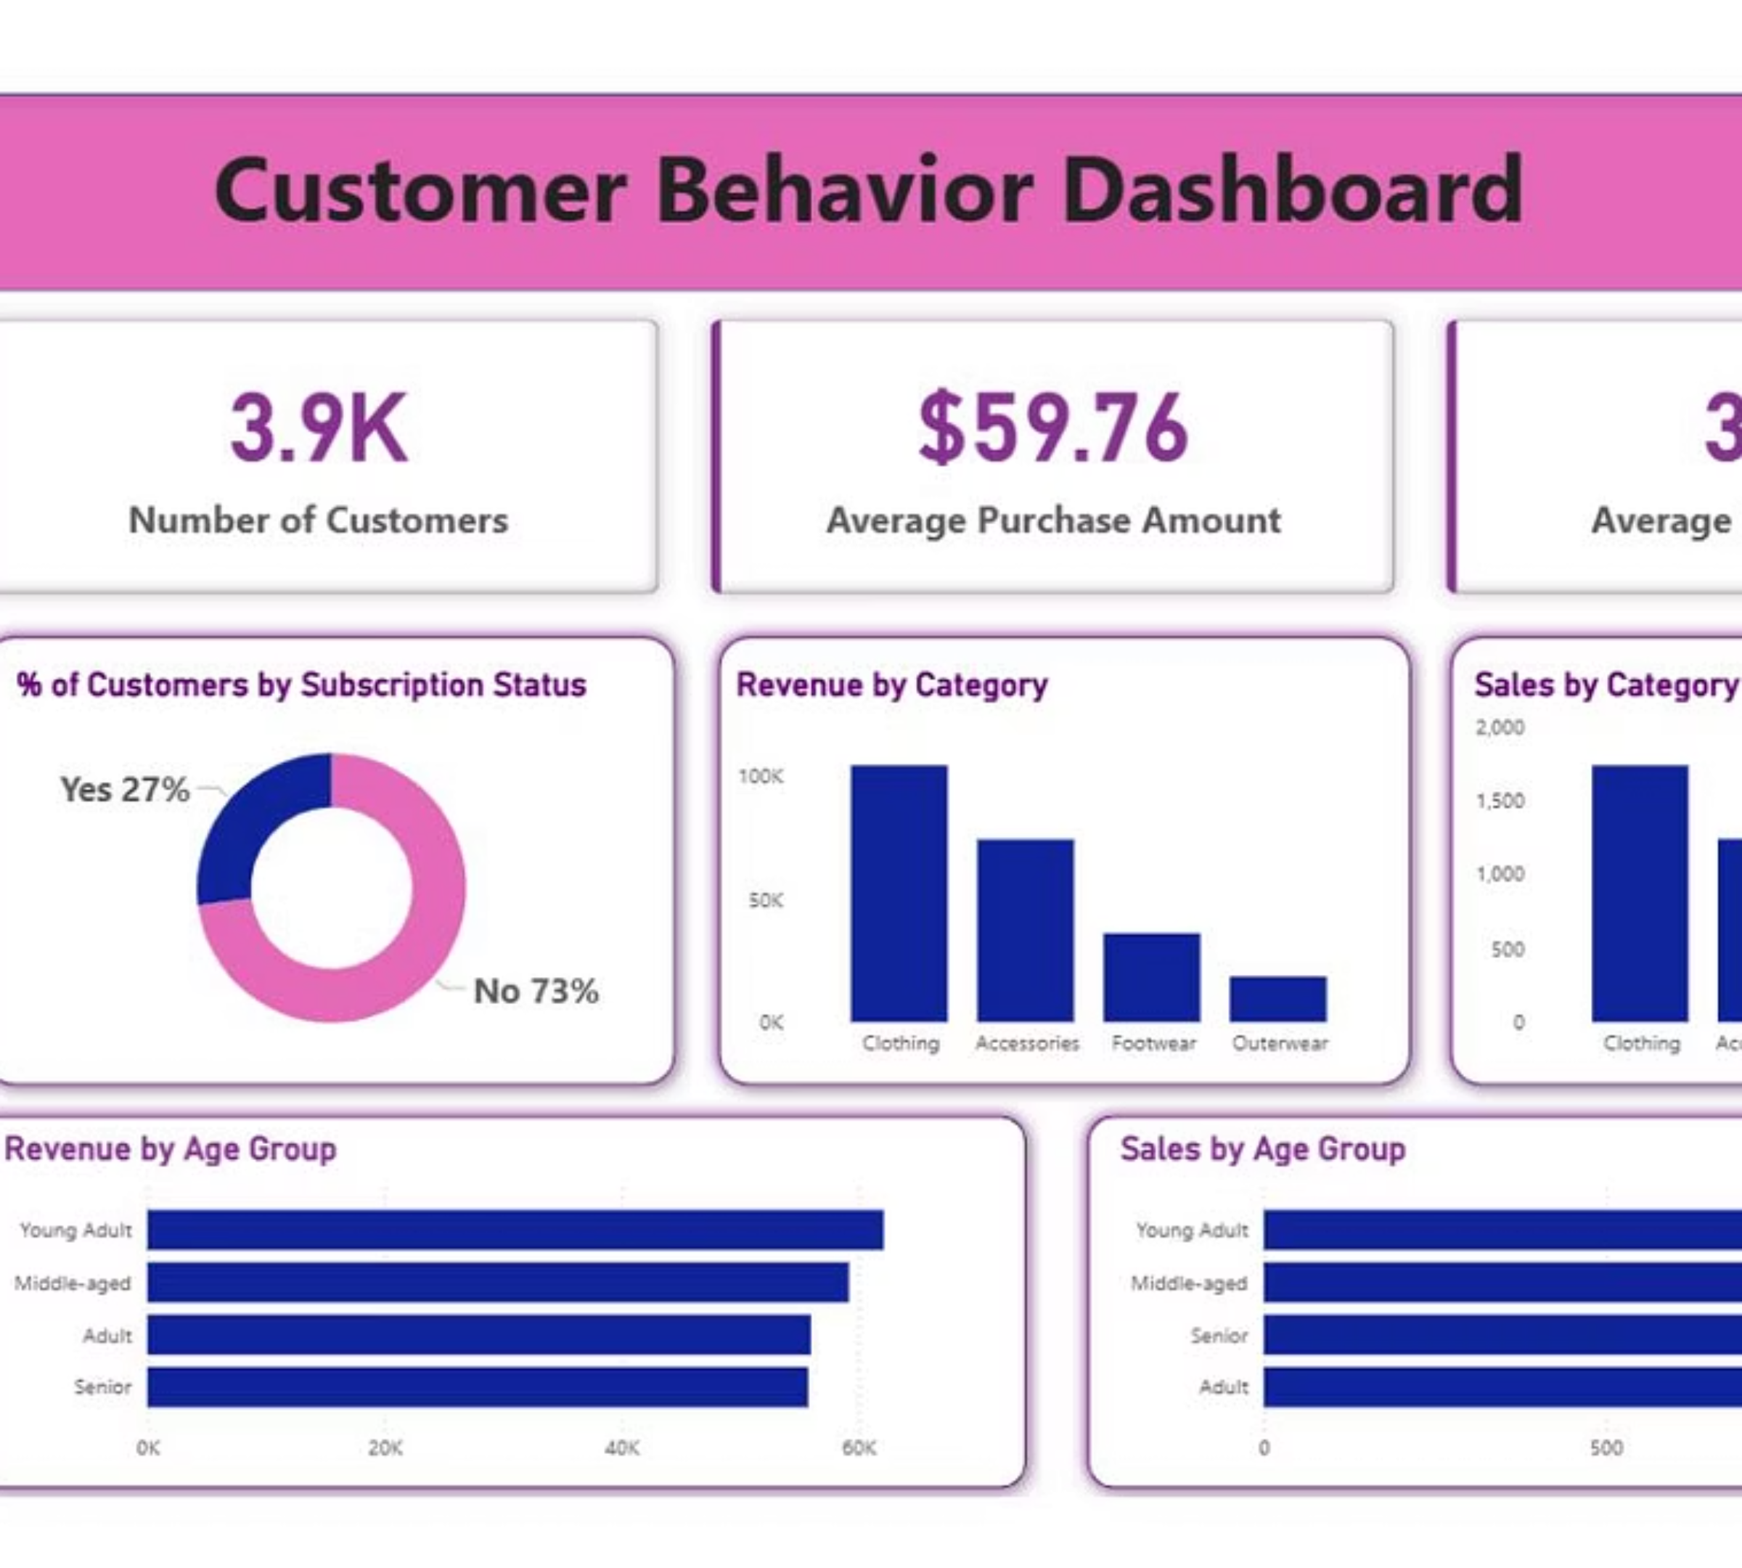
Interactive Dashboard
Our comprehensive Power BI dashboard visualizes key metrics including revenue trends, customer segments, product performance, and demographic insights for real-time business intelligence.

Slide 10



Strategic Recommendations
Boost Subscriptions
Loyalty Programs
Targeted Marketing
Promote exclusive benefits and personalized experiences to convert non-subscribers
Reward repeat buyers to accelerate movement into Loyal segment
Focus on high-revenue age groups and express-shipping users
Review Discount Policy
Product Positioning
Balance promotional sales boosts with margin control to optimize profitability
Highlight top-rated and best-selling products in all marketing campaigns

